Slide 1
Task 4 :
Communicating Insights and Analysis

Slide 2
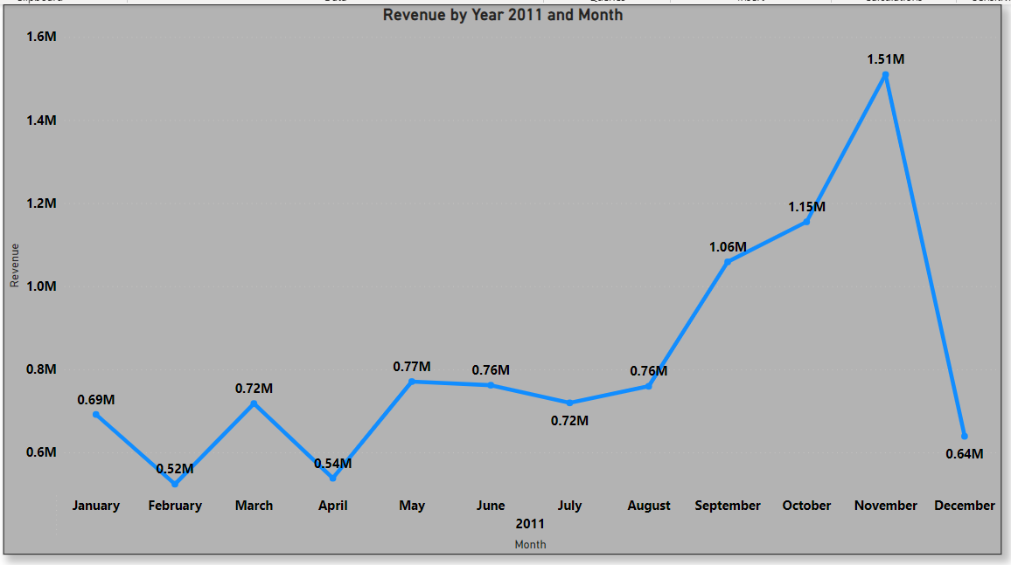

Slide 3
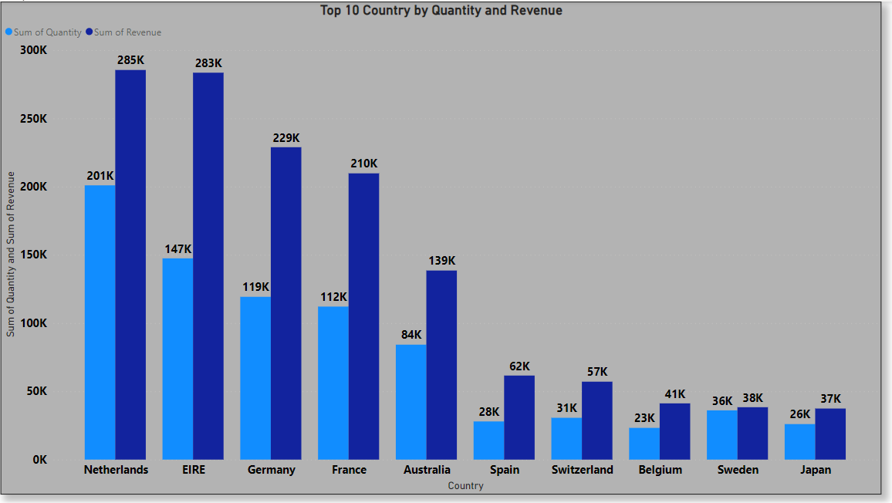

Slide 4
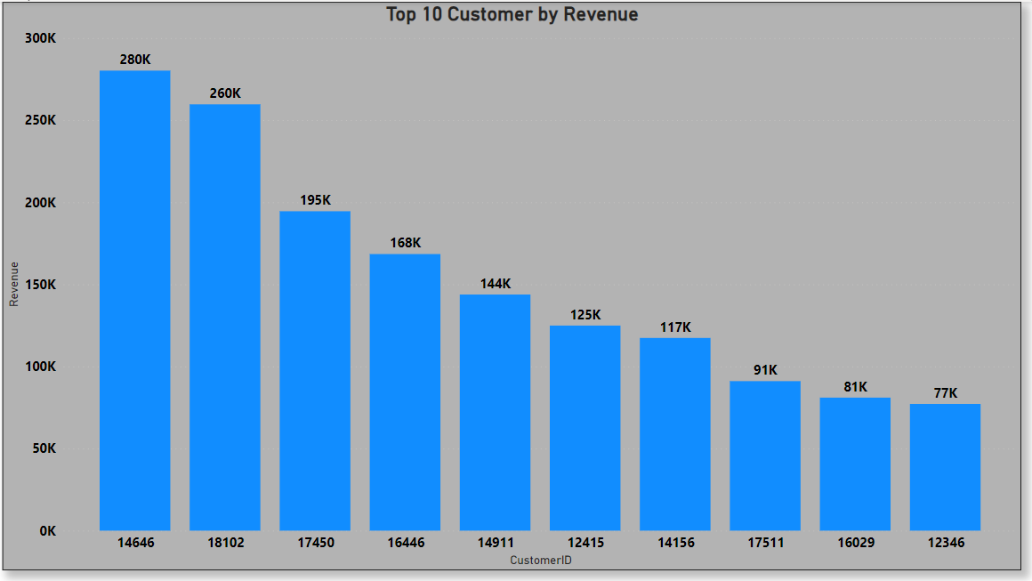

Slide 5
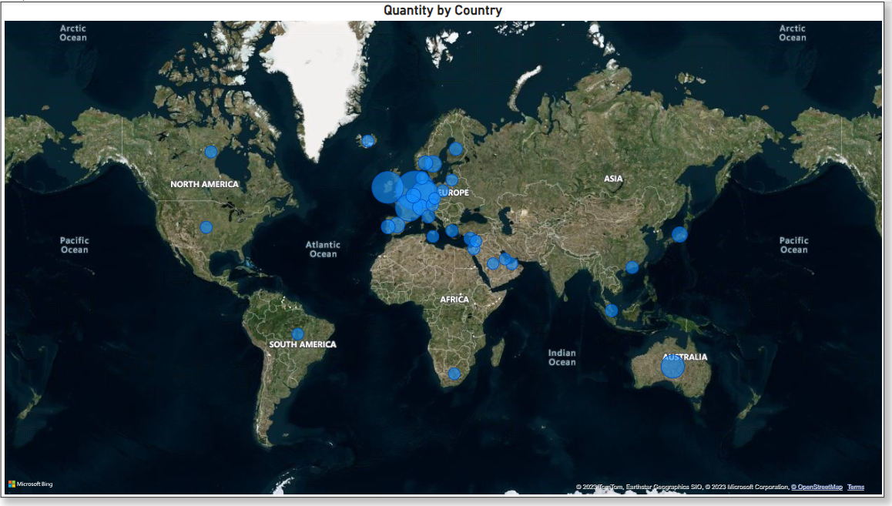

Slide 7
Thanking You!

